Slide 1


Slide 2
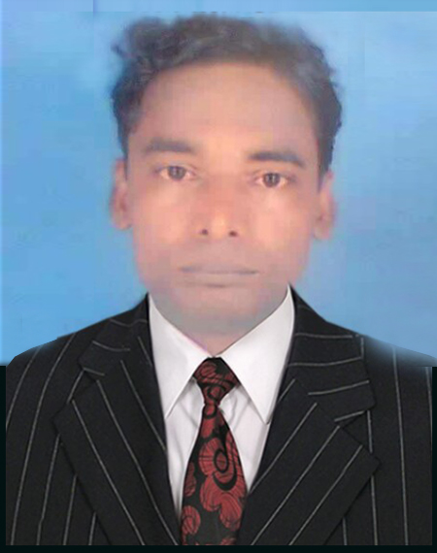
KOMAL KANTA RAY TALUKDER
Assistant teacher
L,P HIGH SCHOOL
Chhatak, Sunamgonj.
Mobile : 01714529249
Email : komalkanta1970@gmail.com

Slide 3

Class : Eight
Subject : English First Paper
Name of topic : Your Class Teacher
Time : 60 minutes
Date :02/02/2016

Slide 4
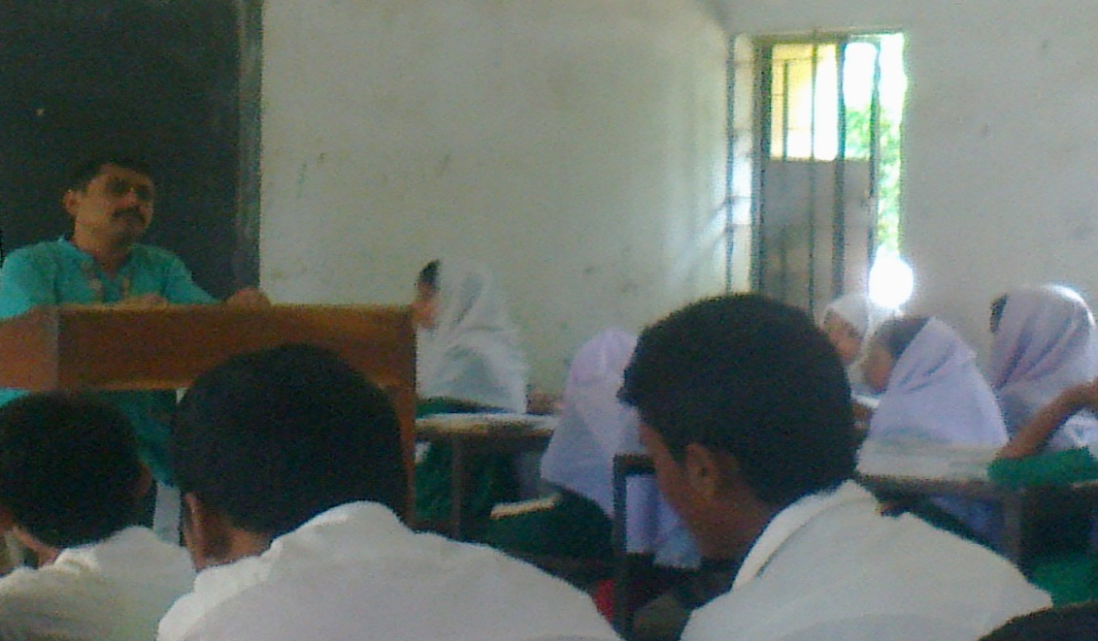
Look at the picture.
Q. Can you guess who he is?
Answer : He is our class teacher.
Notes:
After showing the picture and question teacher will click on the question to show the class teacher.

Slide 5
Let’s discuss about
YOUR CLASS TEACHER

Slide 6
Learning outcomes
By the end of the lesson the students will be able to
Learn word meaning.
Match the similar word.
write a paragraph about their class teacher.

Slide 7
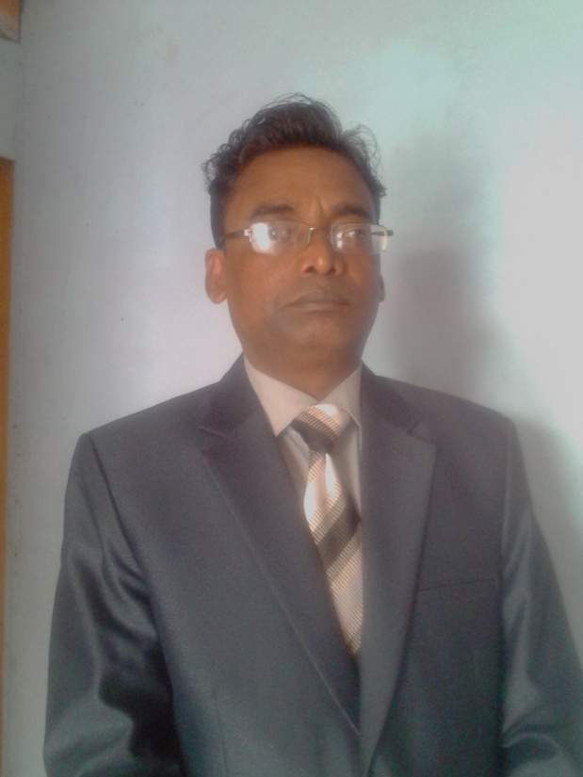
INDIVIDUAL WORK
VOCABULARY
7 MINS.
Smart
Cute
He is so smart.

Slide 8


VOCABULARY
Thoughtful
Pensive
He/She is a thoughtful person.

Slide 9

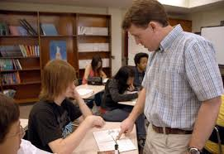
VOCABULARY
Helpful
One who helps others
He / She is helpful .

Slide 10


VOCABULARY
Examiner
One who evaluates the exercise book of examinee
He / She is an examiner.
Sincere
Earnest
He /She sincere to his work.

Slide 11
VOCABULARY
Truthful - সত্যবাদী
Talented - প্রতিভাসম্পন্ন
Tactful - কৌশলী
Energetic - প্রবলভাবে সক্রিয়
Active - কর্মঠ
Amiable - অমায়িক
Creative -সৃজনক্ষম
Honest - সৎ
Humble -নিরহঙ্কারী
Earnest - আন্তরিক
Reflective - চিন্তাশীল
Researcher গবেষক

Slide 12

some adjectives and nouns which are used for a class teacher.
C = Creative
L = Lesson planner
A = Active
S =Smart
S = Sincere
T =Truthful, Talented, Tactful.
E = Energetic
A = Amiable
C =Careful
H = Honest, Humble
E = Eligible; Earnest
R = Researcher, Reflective

Slide 13
#. Match the following words:
Column A
    Column B
a. Truthful
b. Talented
c. Tactful
d. Energetic
e. Active
f. Creative
g. Honest
h. Earnest
Reflective
j. Researcher
1.Sincere
2.Thoughtful
3.Seeker
4. Productive
5. Helpful
6. Veracious
7. Ingenious
8. Artful
9. Energetical
10. Devoted to work
11. Inventive
PAIR
WORK
7 minutes

Slide 14
Match your answers.
a. Truthful = 5. Helpful
b. Talented =7. Ingenious
c. Tactful = 8. Artful
d. Energetic =9. Energetical
e. Active =10. Devoted to work
f. Creative = 11. Inventive
g. Honest = 6. Veracious
h. Earnest = 1. Sincere
i. Reflective = 2. Thoughtful
j. Researcher = 3. Seeker

Slide 15

Look at the following concept map.
Name of a teacher
Age
Educational qualification
Teaching method
Teaching subject

Slide 16
Probable answers
Name of teacher : Komal Kanta Ray Talukder
Age : About 40 years old
Educational Qualification : M.A. ; B.Ed.
Teaching method : Participatory
Teaching Subject : English For Today

Slide 17
Grammar
Structure of Assertive Sentence
2. Subject + Main verb + Object .
1. Subject + be verb of present form (is) + complement.
Example: He is active.
Example : He teaches us English.
Structure of Present Indefinite Tense
Subject + Base form of verb + Object + Extension
He makes his lesson interesting.

Slide 18
Group Work
10 minutes.
Write a paragraph to follow the following questions:
a ) What is the name of your class teacher?
b) How old is he?
c ) What is his qualification?
d) Which subject does he teach?
e) How does he behave?
f) How is his teaching method?
g ) what does he do to make your attention to the lesson?

Slide 19
EVALUATION
Q. Who is your class teacher?
Q. What is the name of his teaching subject ?
Q. How is his teaching method?
Q. What does he do to make your attention to the lesson

Slide 20

HOME WORK
Make a paragraph about
’Your Favourite Teacher’

Slide 21

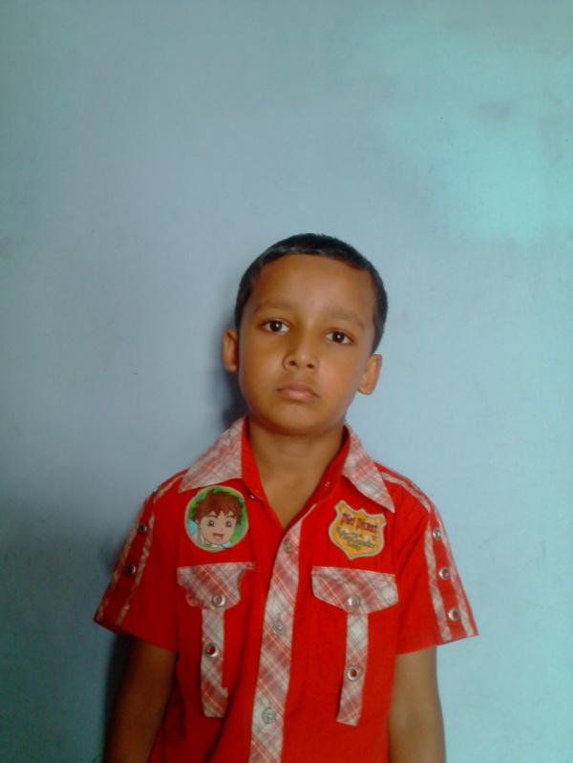
THANK YOU ALL

